Slide 1
Environment Safety Monitor
Vlad-Mihail Teodoroiu
https://github.com/TeodoroiuVlad-Mihail/IOT_project-Environment-Safety-Monitor

Slide 2
Why?
Safety: Detect hazardous events like gas leaks, vibrations (earthquakes), or high noise levels
Multi-location Monitoring: Ability to collect environmental data from multiple locations simultaneously, helping identify the source of anomalies.
Real-time Awareness: Immediate notifications and live dashboard allow timely intervention before small issues become serious.

Slide 3
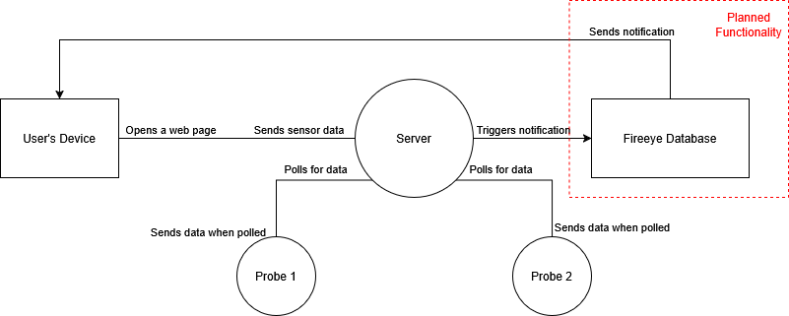
The Plan
Sensor Nodes: collect data then expose it through CoAP
Central Server: polls nodes, stores latest data, serves web dashboard
Web Interface: Live display of multiple nodes, auto-refresh, JSON debug output
Notifications

Slide 4
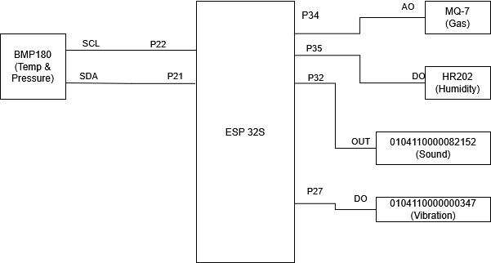
Hardware
ESP32 boards as sensor nodes
Sensors: BMP180, HR202, MQ-7, motion, sound

Slide 5
Software
Sensor Nodes (ESP32):
Act as independent CoAP servers
Expose sensor values: temperature, humidity, pressure, CO, vibration, sound
Lightweight firmware: sensor drivers + network logic
Central Server (Node.js):
Polls multiple sensor nodes periodically
Stores latest readings per node
Serves live dashboard to web clients (desktop & mobile)
Triggers alerts when readings exceed safe thresholds
Web Interface:
Displays live sensor values for all nodes
Auto-refresh and raw JSON output for debugging
Accessible from any device on the network

Slide 6
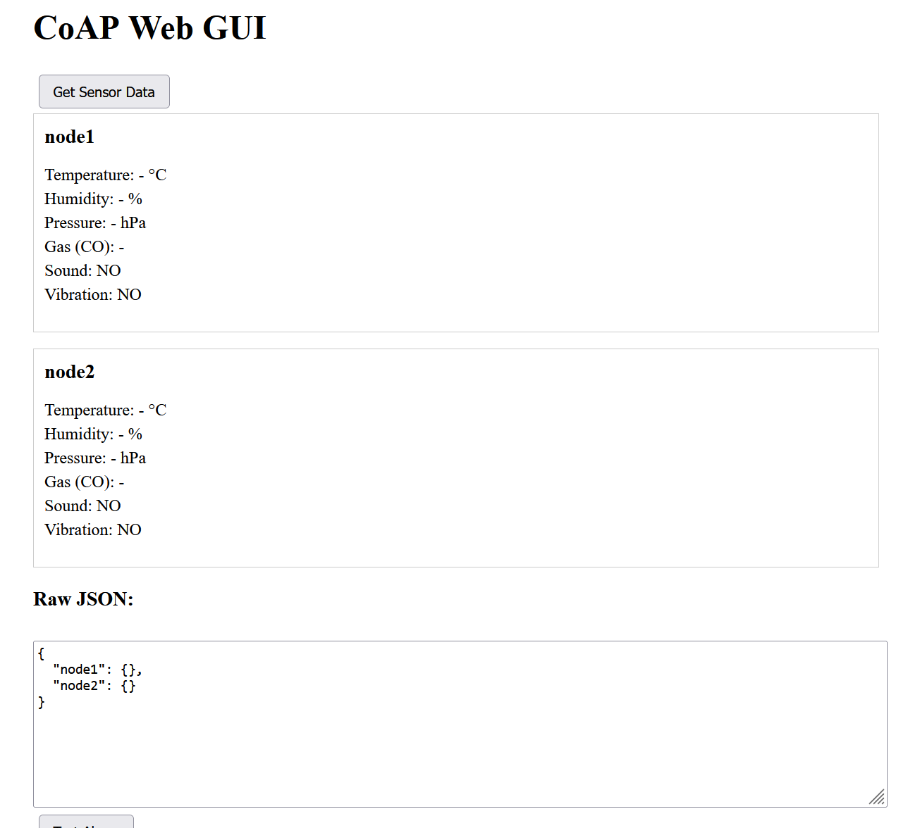
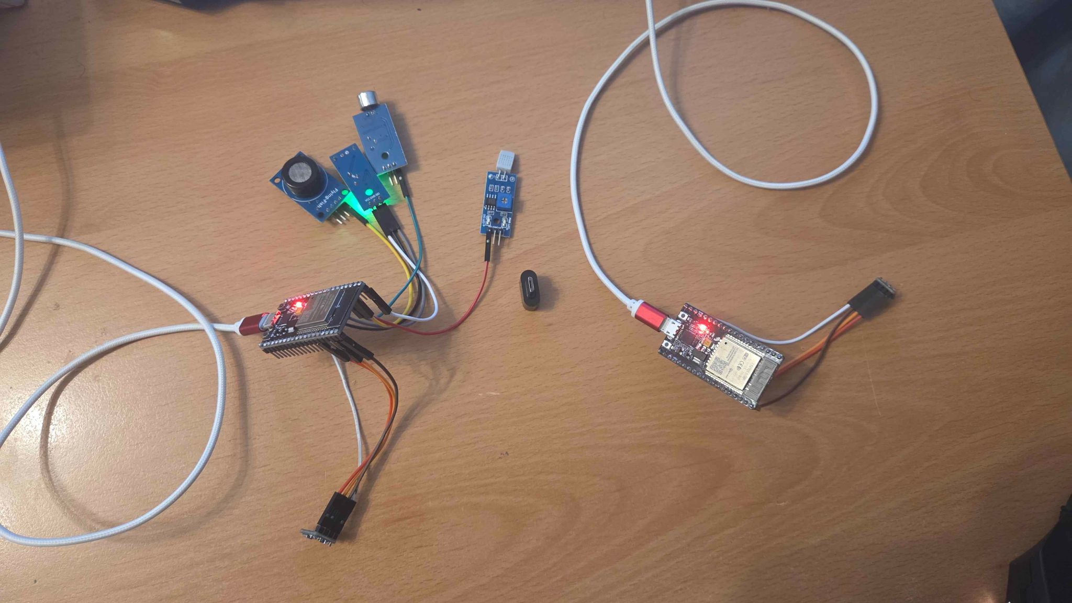
Testing
Tested with 2 nodes: primary full sensors, secondary BME-only
Web app shows independent live data
Alerts triggered based on thresholds

Slide 7
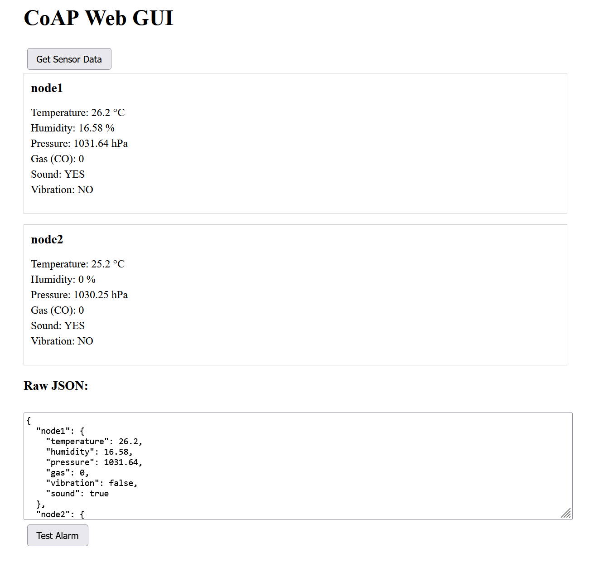
Features
Multi-node support (independent operation)
Threshold-based alerts: CO, vibration, temperature, pressure
Resilient server: continues polling even if one node fails
Accessible from mobile & desktop

Slide 8
Thank you

